Slide 1
VTA ：An Open Hardware-Software Stack for Deep Learning
Transformer计算优化组第1次汇报
报告人 陈宇童

Slide 2
目录
论文信息
论文内容
主要贡献
小组进展汇报

Slide 3
论文信息

Slide 4
论文信息
1. 标题 ：VTA ：An Open Hardware-Software Stack for Deep Learning
2. 作者 ：Thierry Moreau, Tianqi Chen, Ziheng Jiang, Luis Ceze, Carlos Guestrin, Arvind Krishnamurthy
3. 刊物/会议：axriv
4. 时间：2018
5. 链接：arxiv.org/abs/1807.04188

Slide 5
论文内容

Slide 6
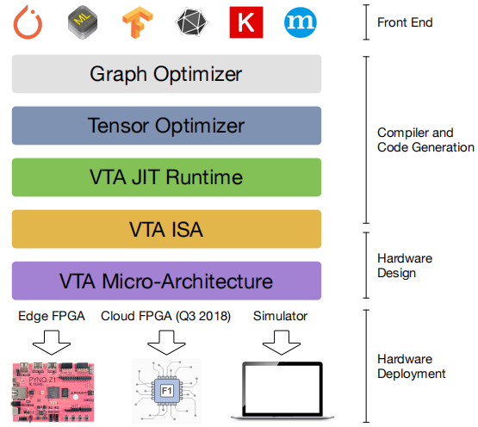
论文内容-Introduction
Versatile Tensor Accelerator(VTA, pronunced vita)
VTA is an end-to-end solution that includes drivers, a JIT runtime, and an optimizing compiler stack based on TVM.
Transparant
End-to-end
From software-to-hardware(full stack)
Figure 1 : Overview of VTA Stack

Slide 7
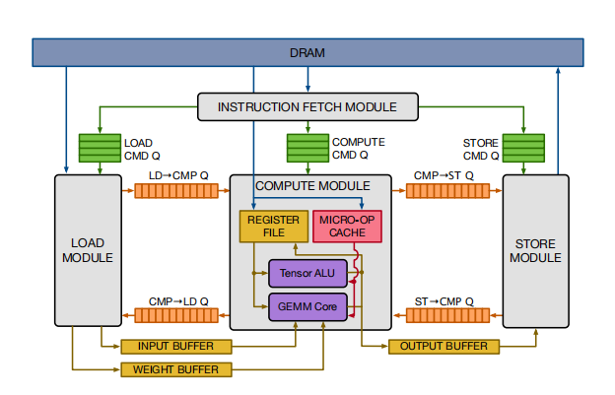
论文内容-VTA Hardware Architecture
VTA Design Overview
Fetch Module :
(1)loading an instruction stream from DRAM;
(2) decoding the instruction;
Load Module : loading input and weight tensors from DRAM into memories;
Figure 2 : The VTA Hardware Organization
CMP Core Message Protocol
LD Load
ST Store
CMD Command
Q Queue

Slide 8
论文内容-VTA Hardware Architecture
Compute Module :
(1)Compute : dense linear algebra computation with GEMM core & general computation with tensor ALU;
(2)Loading : DRAM to Register File & Micro-OP Cache；
Store Module : Store Computing results from Compute Module to DRAM;
Figure 2 : The VTA Hardware Organization
CMP Core Message Protocol
LD Load
ST Store
CMD Command
Q Queue

Slide 9
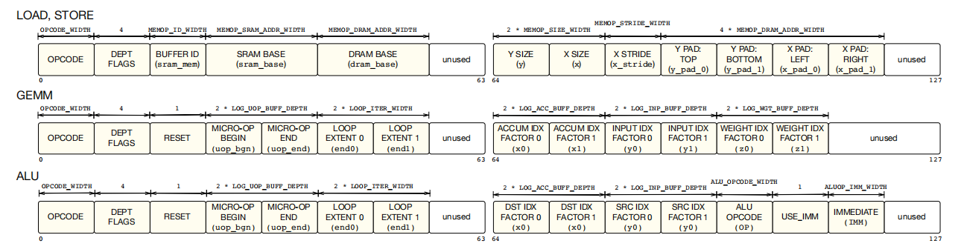
论文内容-VTA ISA
High Level Instruction Set (CISC) :Complex Instruction Set Computer
Figure 3: The VTA CISC instruction fields

Slide 10
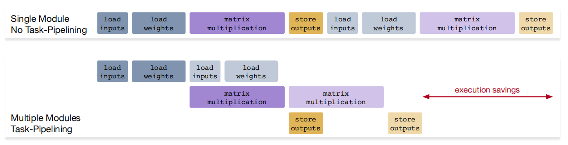
论文内容-Task-Level Pipeline Parallelism
Lantency Hiding
Figure 4:Task-Level Pipeline Parallelism(TLPP)

Slide 11
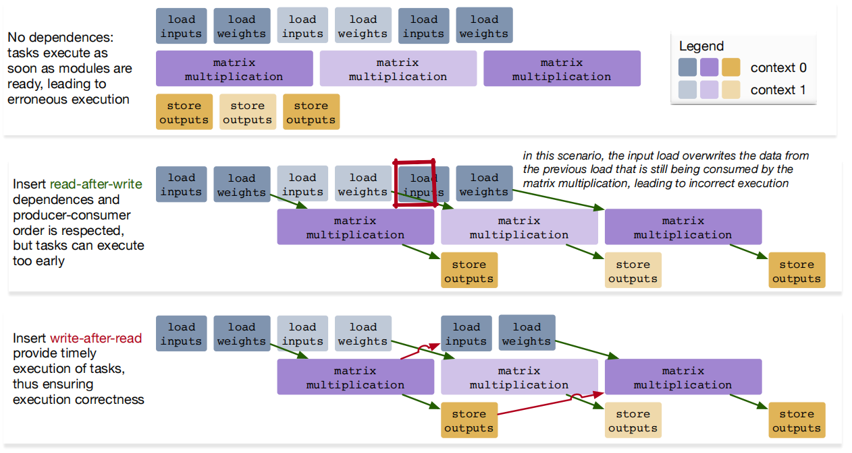
论文内容-Task-Level Pipeline Parallelism
Data Dependences
Read-After-Write(RAW)
Write-After-Read(WAR)
Figure 5: Inserting data dependences between

Slide 12
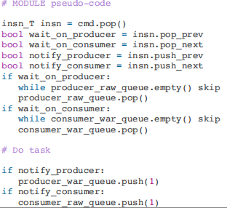
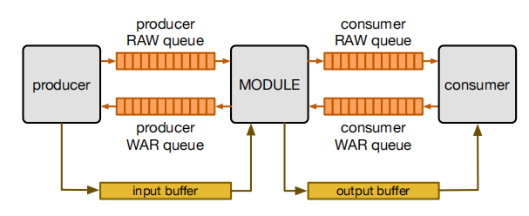
论文内容-Task-Level Pipeline Parallelism
Dataflow Execution & Pipeline Expandability
Figure 6 : The Hardware Organization & pseudo-code

Slide 13
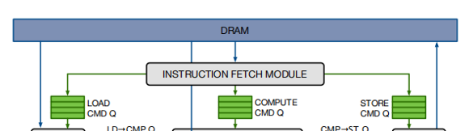
论文内容- Instruction Decoding with the fetch Module
The read-write control register starts the fetch module, and is read to check for its completion.
The write-only insn_count register sets the number of instructions to execute.
The write-only insns register sets the start address of the instruction stream in DRAM
the command queues becomes full—>the fetch module stalls

Slide 14
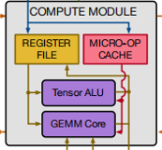
论文内容-VTA Compute Core
Micro-Ops : ALU / GEMM Ops && executes micro-ops sequences inside a two-level nested loop
GEMM : Matrix - Matrix multiplication && 2D Convolutions
ALU : Vector - Activation && Pooling && Normalization

Slide 15
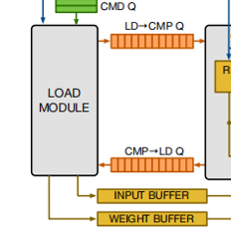
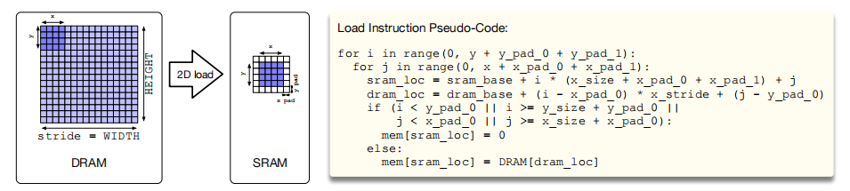
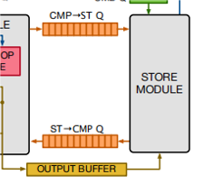
论文内容-VTA Memory SubSystem
One Level On-chip Memory Hiearchy
Data-specialized
Each buffer has a Single Reader and a Single Writer to allow Coherent Excution
Figure 9 : the Load Module with Strided Access and 2D Padding on-the-fly
Bandwidth Considerations : Divergence in Bandwidth Requirements - why Data-specialized
Memory Access Latency Hiding : DMA transfers from DRAM to SRAM / from SRAM to DRAM
Tiled Access Patterns : strided 2D accesses && insert 2D padding on-the-fly

Slide 16
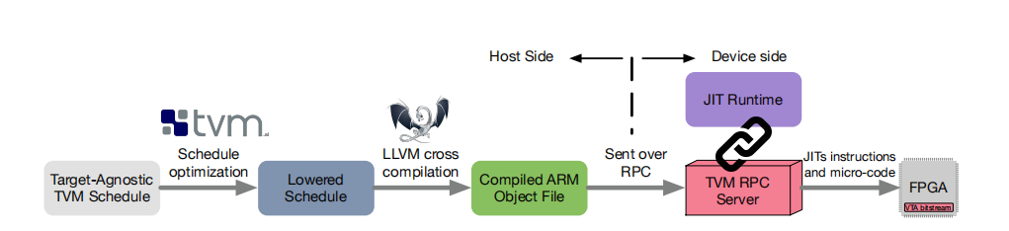
论文内容-VTA Runtime System
Compilation Overview
Figure 10 : TVM Compilation Flow

Slide 17
论文内容-VTA Runtime System
JIT Runtime
Dynamic memory allocation and buffer management.
Direct Memory Access (DMA) transfers between main memory (DRAM) and accelerator memory (SRAM).
Micro-op kernel generation and caching.
Explicit dependence management in the instruction stream.
Synchronization between the target CPU and VTA .

Slide 18
论文内容-TVM Support for VTA
Explicit Memory Management
Tensorization
Explicit Memory Lantency Hiding

Slide 19
论文内容-Evaluation
Notes
A Preliminary Evaluation on Pynq
Emphasize the full stack at work, Not the peak performance
Platform
ARM Cortex A9 dual core CPU (667MHz)
Artix-7 FPGA
8bit value & 16×16 matrix-vector units(100MHz) & 32bit register for accumulation
Peak Throughout 51GOPS (Giga Operations Per Second)
16kB microkernel cache & 32kB activation storage & 256kB parameters storage & 128kB register file
On-chip buffers NOT LARGE ENOUGH for single layer of ResNet —> effective memory reuse and memory access latency hiding

Slide 20
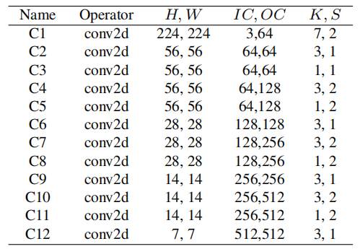
论文内容-Evaluation
Benchmark
MxNet+ResNet-18
32bit float to 8bit fixed
Padding : "SAME"
CPU : C1 && Max Pooling Layer && Fully Connect Layer
FPGA ： C2-C12 && Activation && Batch Normalization
Accuracy 63%
table 1 : Configurations of all Conv2d
H : Height W : Width IC : Input Channels OC : Outout Channels K : Kenerl Size S : Stride

Slide 21
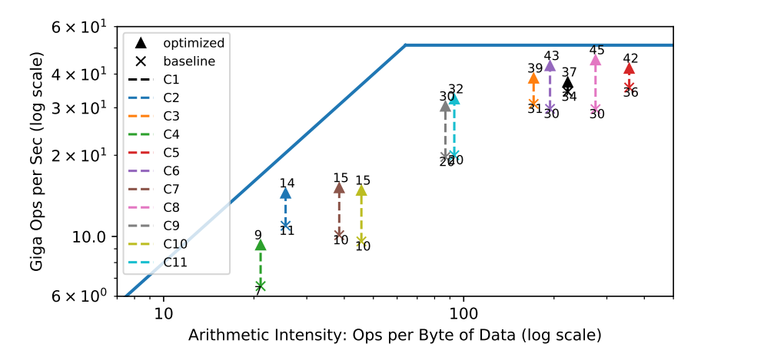
论文内容-Evaluation
Resource Utilization Efficiency
Latency Hiding —> Much closer to the roofline, Higher Compute and Momery Bandwidth Efficiency
Each Layer has a different Arithmetic Intensity :Left half Bandwidth Limited; Right half Compute Limited;
Figure 15 : Roofline of an FPGA-based deep learning accelerator running ResNet inference

Slide 22
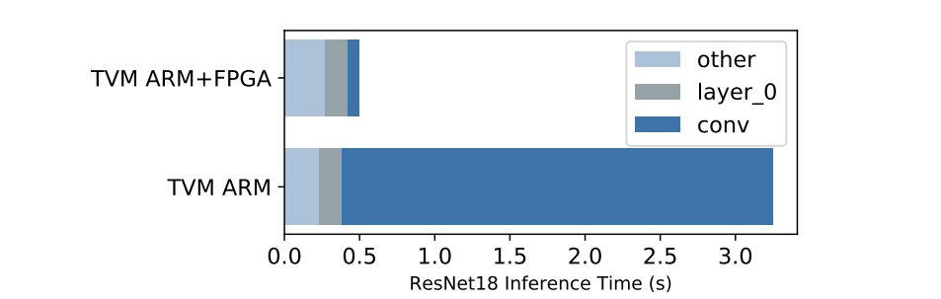
论文内容-Evaluation
End-to-end ResNet Evaluation
The FPGA provide a 40× acceleration on offload convolution layers(ONLY) over Cortex A9
Figure 16 : ResNet18 Inference Time Comparison

Slide 23
主要贡献

Slide 24
主要贡献
1. Provide a common deep learning system stack for hardware, compilers, and systems researchers alike to incorporate state-of-the-art optimizations and co-design techniques.
2. Lower the barrier of entry for machine learning practitioners to experiment with novel network architectures,operators and data representations that require specialized hardware support.
3. Understand what performance bottlenecks and Amdahl limitations stand in the way

Slide 25
主要贡献-Use-case Scenerios
Hardware Designers and Computer Architects
Optimizing Compilers Researchers
Deep Learning Researchers

Slide 26
组内进展

Slide 27
组内进展
完成TVM环境配置，完成了部分tuitorial
阅读VTA的论文与稀疏矩阵乘法计算优化的论文，对二者有了初步的计算
阅读部分VTA底层代码，对底层逻辑有了一定了解
完成任务分解与任务规划，形成明确时间点与预期目标

Slide 28
感谢观看
创寰宇学府 育天下英才
报告人 陈宇童

